Slide 1
Assignment 6
16102284 Lee Sung Ho

Slide 2
Table of Contents
01
EDA & Data Preprocessing
02
Select Variables
– Sequential algorithms
03
Create & Evaluate Models
04
Conclusion

Slide 3
1. EDA & Data Preprocessing

Slide 4
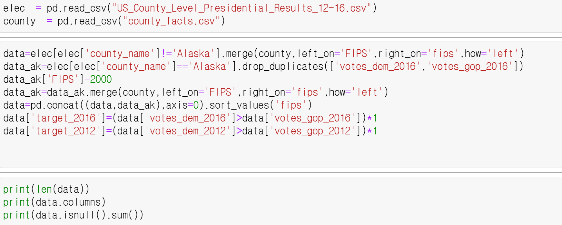
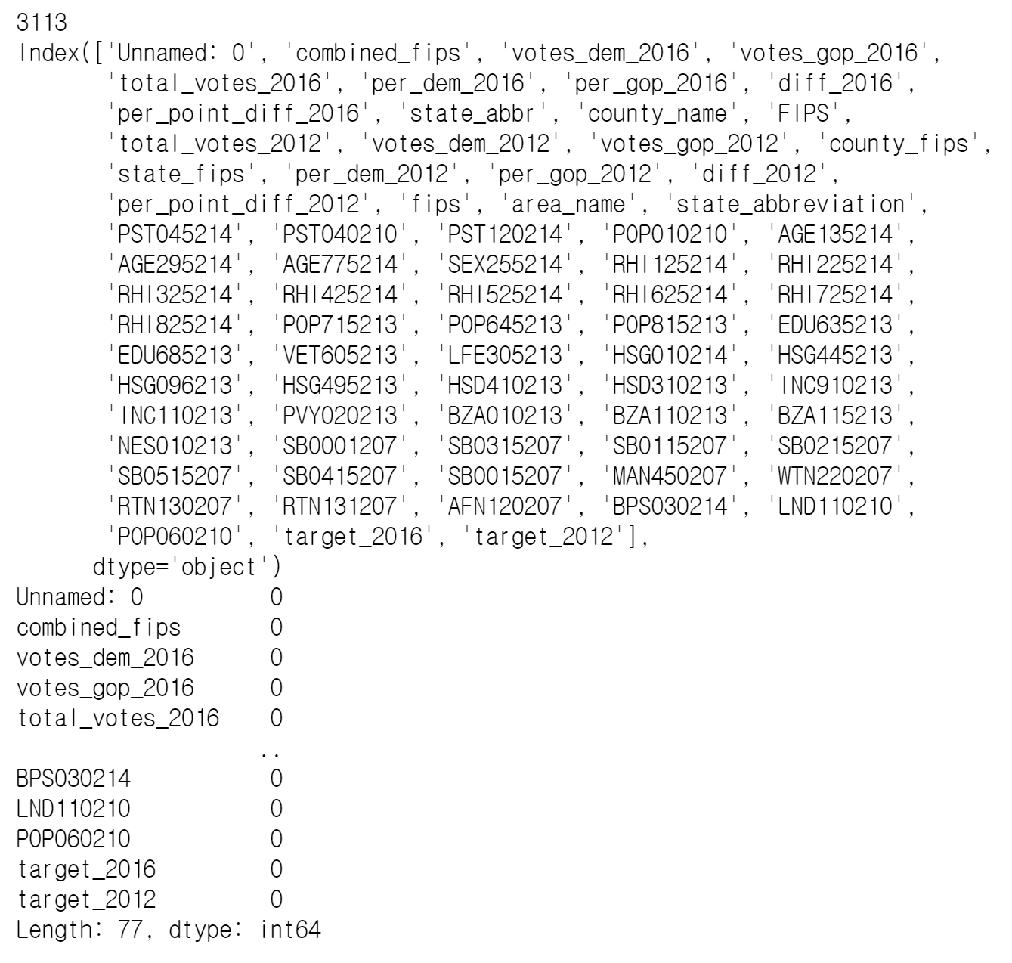
EDA & Data Preprocessing
First, I remake DataFrame which are merged result.csv and county_fact.csv. And I check null point, shape and columns. As a result, there is no null point at data and length is 3113, which is a small size I think.

Slide 5
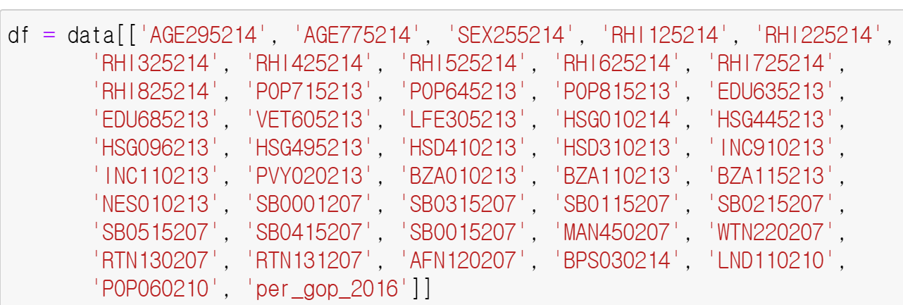
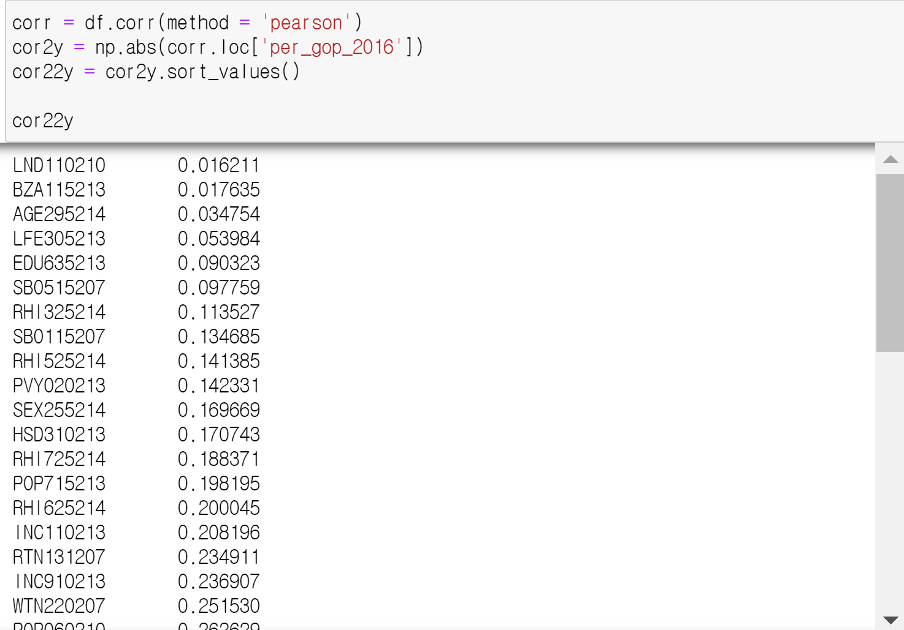
EDA & Data Preprocessing
Our goal is to create a model that predicts targets with county_fact.csv data. And target is made using Democrats and Republicans’s vote rates. So I think high correlation with ‘per_gop_2016’ is also high correlation with ‘target_2016’. So I check absolute amount of correlation variables and target.

Slide 6
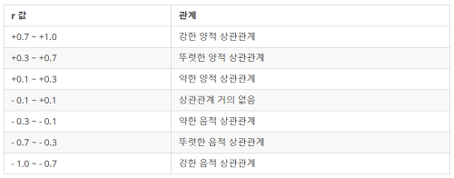
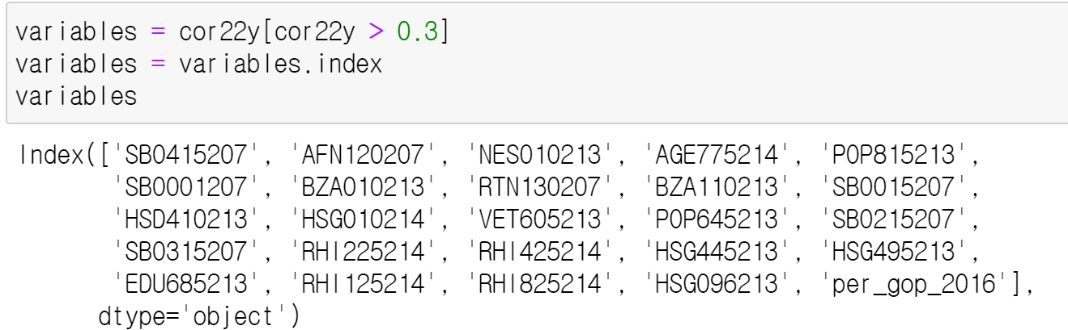
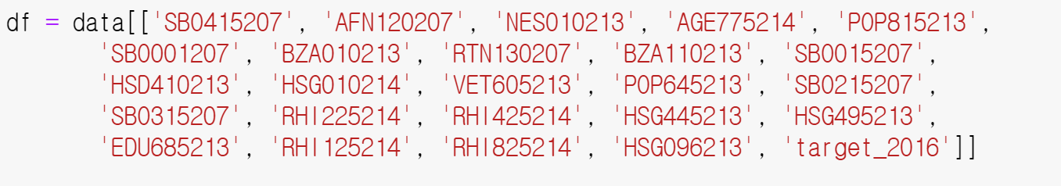
EDA & Data Preprocessing
For these table, I drop variable if r value is less than 0.3

Slide 7
2. Select Variables – Sequential algorithms

Slide 8
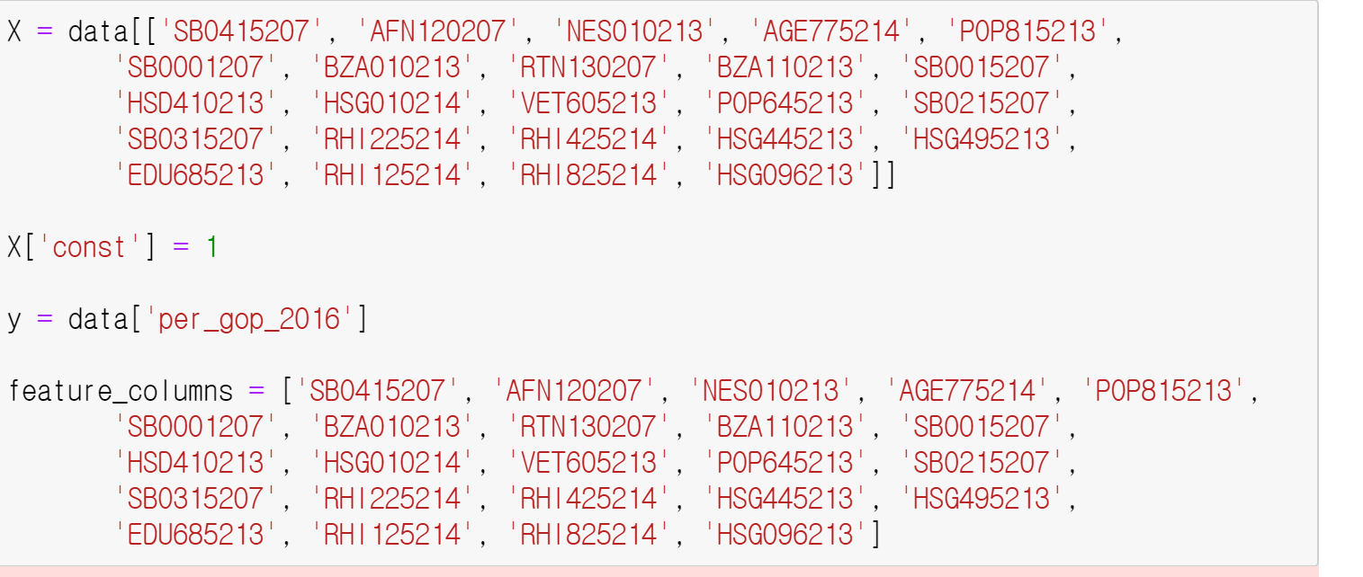
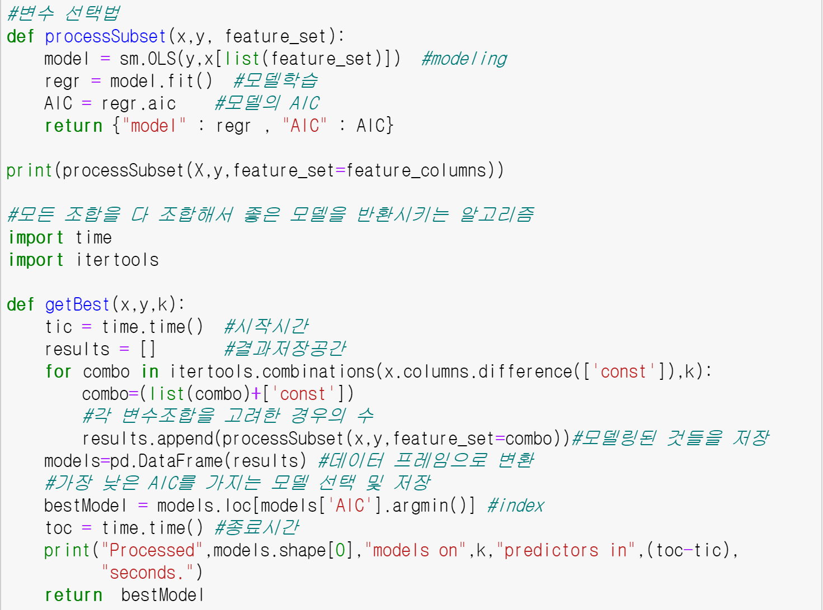
Sequential algorithms
However correlation is different to causal relation. For example, When there are data that sell ice cream well in summer and data that sell umbrellas well in summer, comparing the two data, umbrella sales and ice cream sales do not have a causal relationship, but correlation is high. That's why I'm going to use the ‘Sequential Algorithms’.

Slide 9
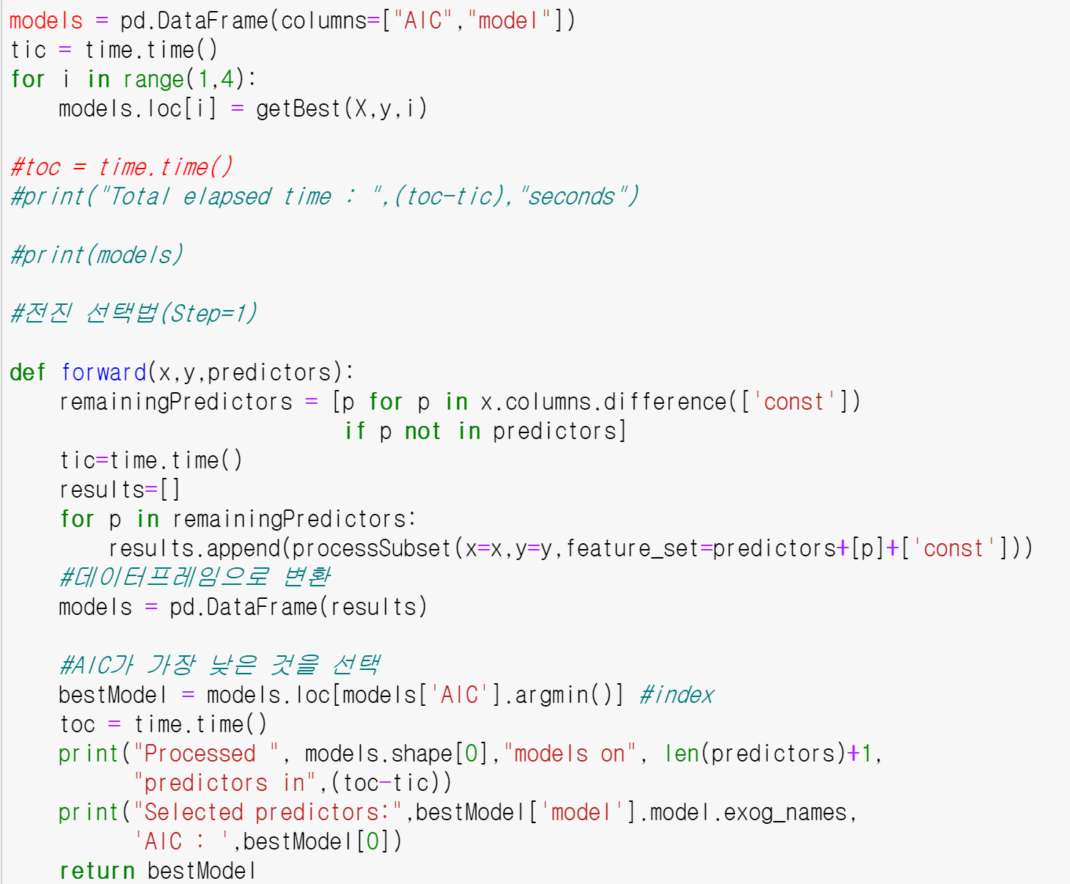
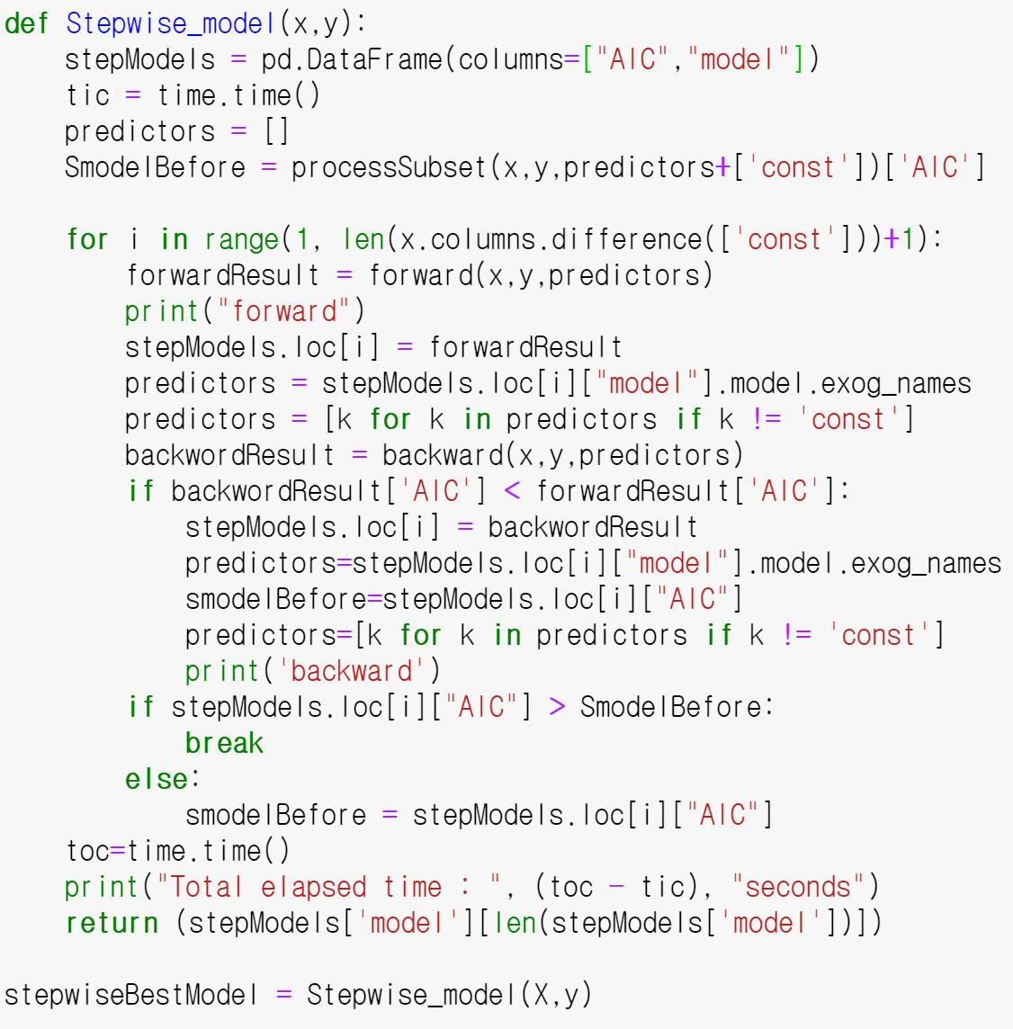
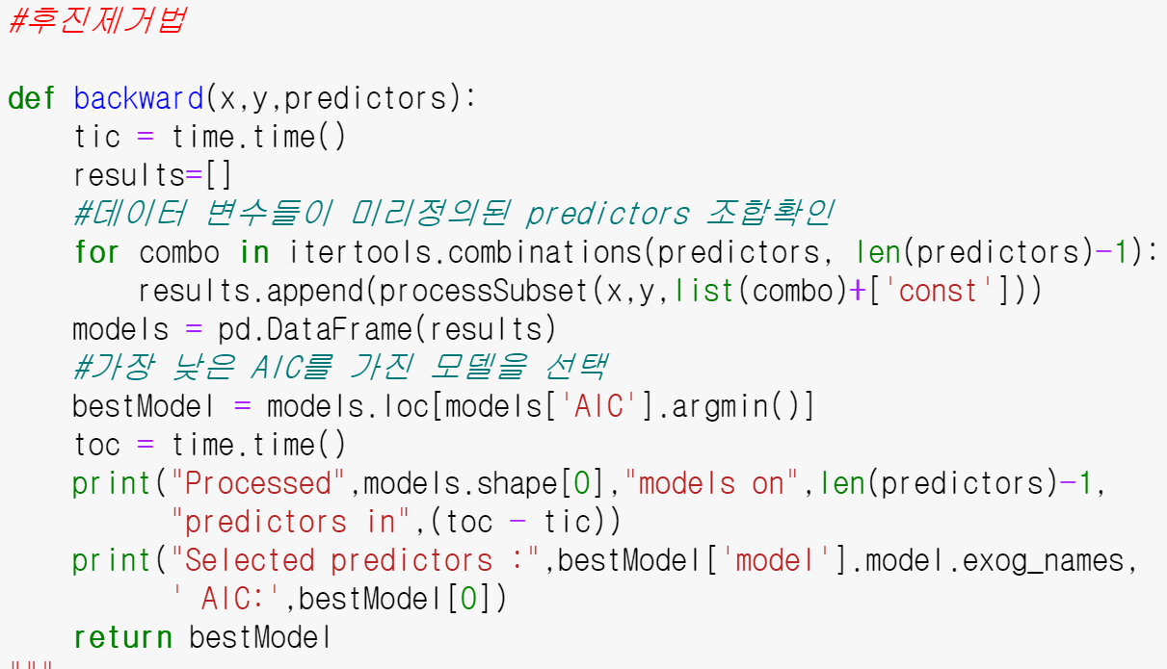
Sequential algorithms
So I use stepwise algorithm which is removes a variable that starts from a model that contains all variables and is most unhelpful to the baseline statistic, or adds the variable that best improves the baseline statistic among the variables that are missing from the model. Repeatedly adding or removing these variables.

Slide 10
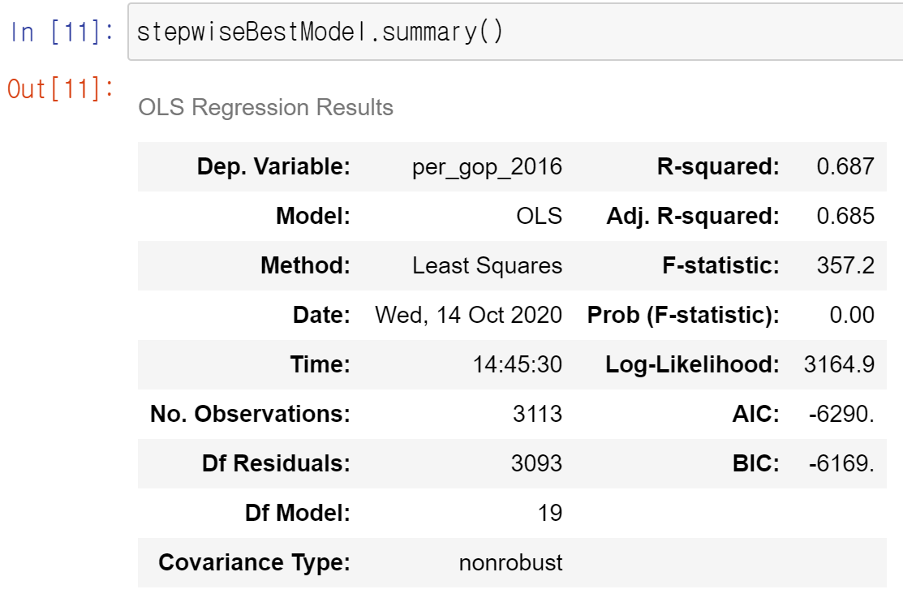
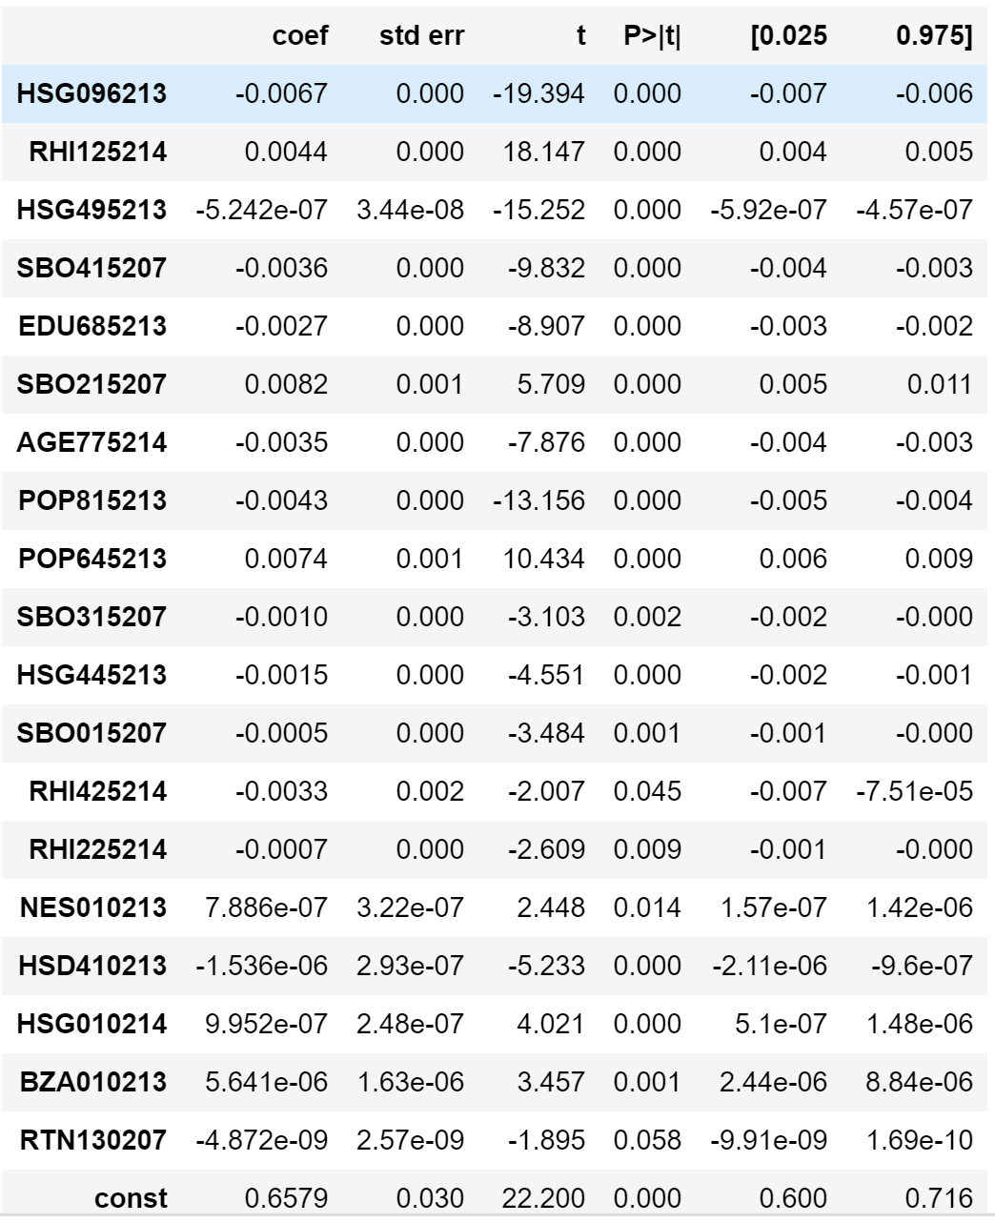
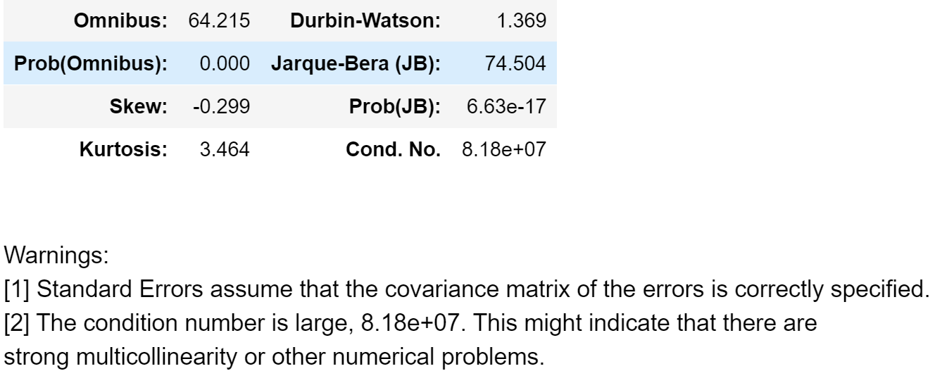
Sequential algorithms
And this is result. Score is quite nice to 0.687 and there is some F-test score problems at variables, however it isn’t our final model, just helping model to choose variable at logistic model, so I use these variables fully.

Slide 11
3. Create & Evaluate Models

Slide 12
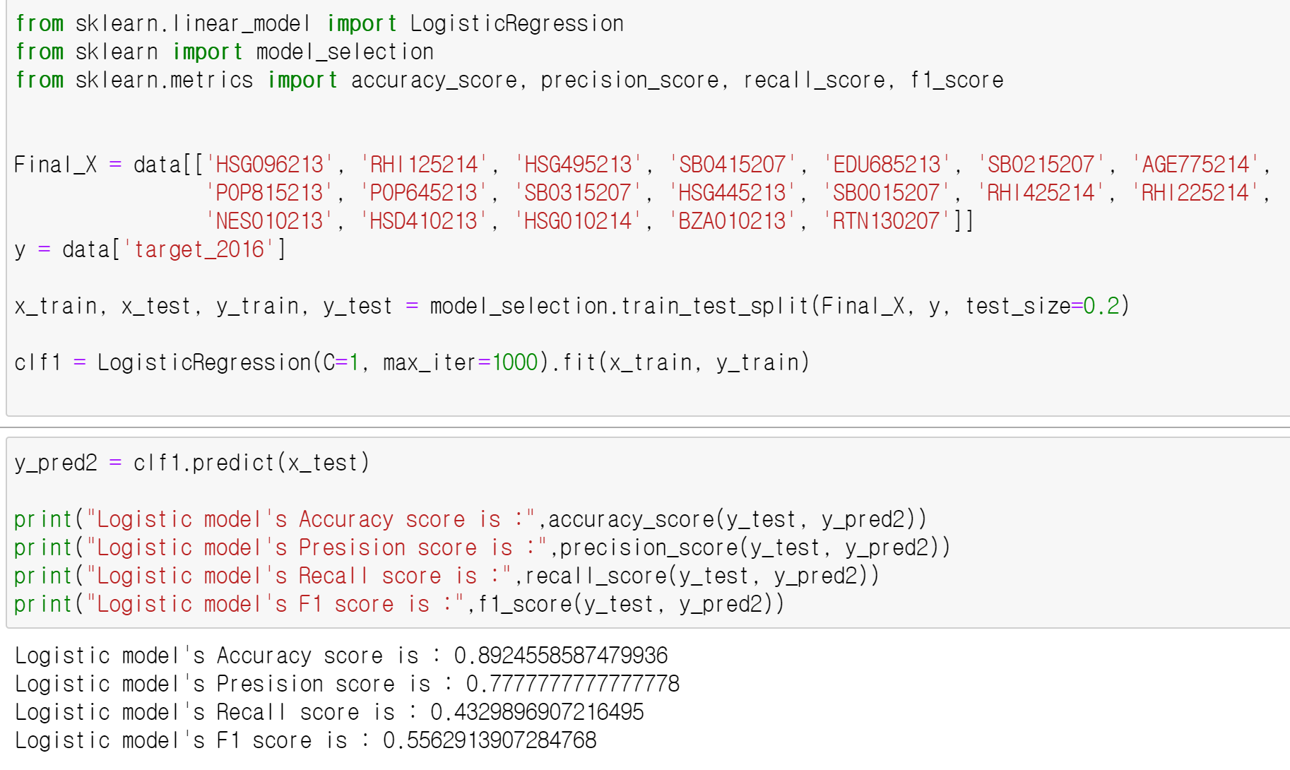
Create & Evaluate Models
I create logistic model. Train and test data are separate randomly. As a result, these model’s accuracy score and precision score are nice, but another score are isn’t good. So I think these model is overfitting. Moreover data’s size is too small to separate train and validation data set, score’s range of change is great.

Slide 13
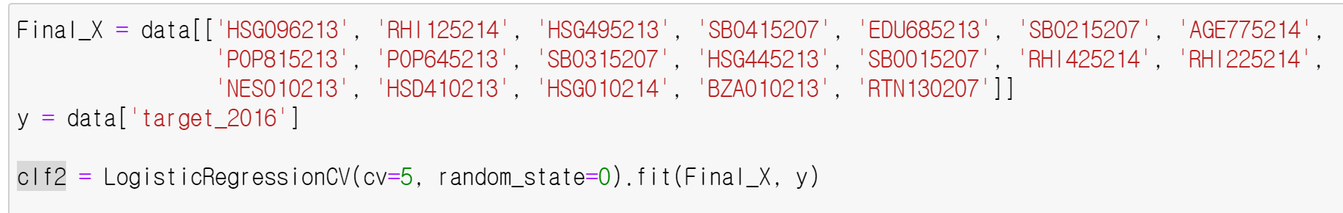
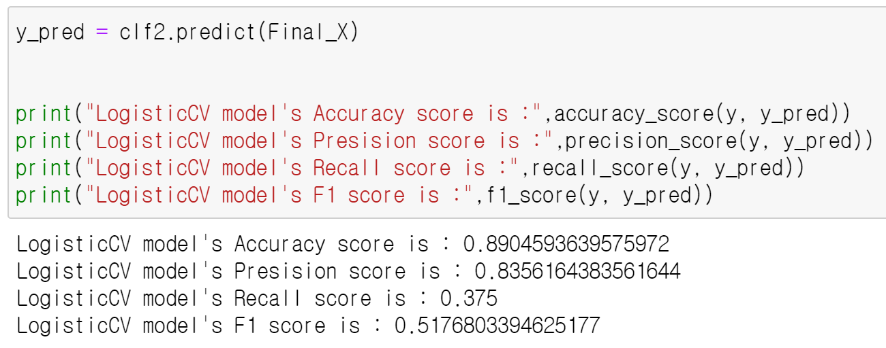
Create & Evaluate Models
To solve these problem, I create logistic model using cross validation method. So I create model and fit using final data.
As a result, score is down compare to before model. Because dataset is so small, it is good to use cross validation. So I think the overfit phenomenon seems to have been resolved a little.
But using cross validation model, the performance of the model is still not good.

Slide 14
4. Conclusion

Slide 15
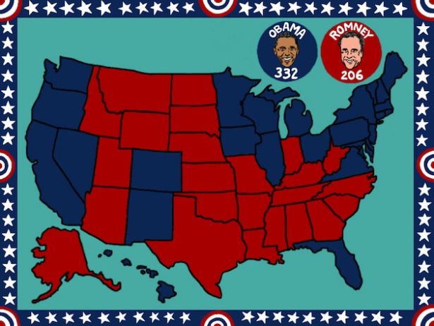
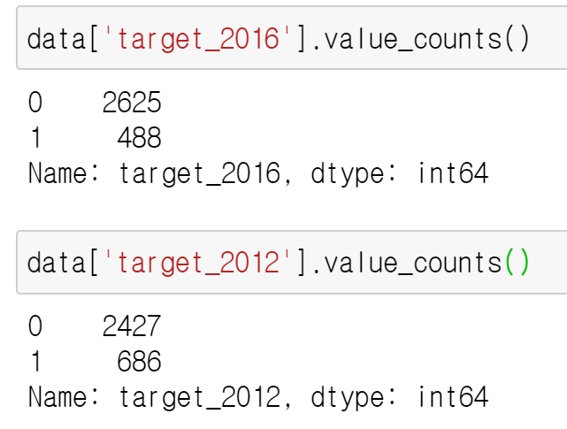
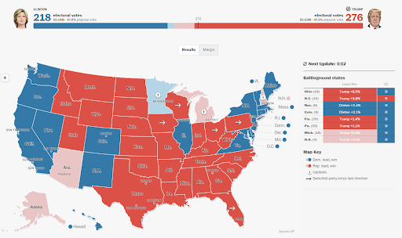
Conclusion
The reason for this phenomenon seems to be that the data is strange first. In 2012, Barack Obama, a Democrat, was elected U.S. But data show that Republican Mitt Romney was elected. This raises doubts about the reliability of this data.

Slide 16
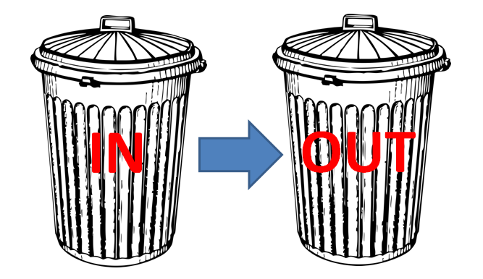
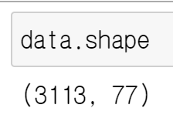
Conclusion
GIGO
Moreover, the data size is small to make logistic regression enough. So I can’t preprocess well.
As a result, all A.I. technologies have to have good data to see good results.

Slide 17
THANK YOU
Insert the Sub Title of Your Presentation

